Slide 1
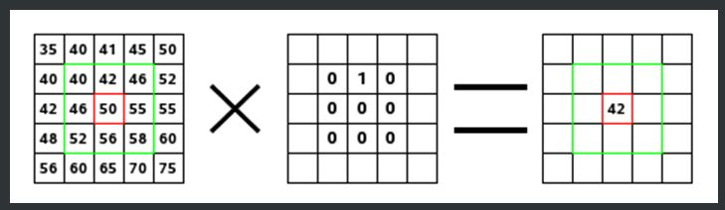

Concept 1: Computing Weighted Sum

Slide 2
Concept 2: Convolution
Is an operation between two tables of numbers,
usually between an image and weights.
Typically, if one table is smaller, it is on the right of the operator
*
[ ] [ ] = ???
Image Weights
*
-1 +1
-2 +2
0 2
1 3

Slide 3
Edge Detection
The purpose of Edge Detection is to find jumps in the brightness function (of an image) and mark them.

Slide 4
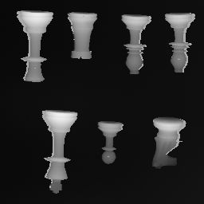
Consider this picture

Slide 5
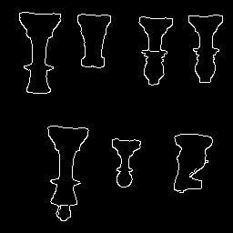
We would like its output to be

Slide 6
Edge Detection
So, to repeat: The purpose of Edge Detection is to find jumps in the brightness function (of an image) and mark them.

Slide 7
Edge Detection
Create the algorithm in pseudocode:
while row not ended // keep scanning until end of row
select the next A and B pair
diff = //formula to show math
if abs(diff) > Threshold //(THR)
mark as edge
A
B
*
-1
+1

Slide 8
Edge Detection: Pixel Values Become Gradient Values
2 pixel values are derived from two measurements
Horizontal
Vertical
A
B
*
-1
+1
Note: A,B pixel pair will be moved over
whole image to get different answers at
different positions on the image
A
-1
*
B
+1

Slide 9
The Resulting Vectors
Two values are then considered vectors
The vector is a pair of numbers:
[Horizontal answer, Vertical answer]
This pair of numbers can also be represented by magnitude and direction
Notes:
Maybe students have seen this before in Math class. Geometry or Alg I.

Slide 10
Edge Detection: Vectors
The magnitude of a vector is the square root of the numbers from the convolution
√
The answer to this equation yields the difference of brightness between neighboring pixels. Higher number means a greater sudden change in brightness.
(a)² + (b)²
a is horizontal answer
b is vertical answer
We can plot the output of this equation onto a 2 dimensional image to show edges.

Slide 11
Edge Detection: Deriving Gradient, the Math
The gradient is made up of two quantities:
The derivative of I with respect to x
The derivative of I with respect to y
∂ = derivative symbol
∆ = is defined as
=
I = [ ]
∆
∂ I ∂ I
∂x , ∂ y
|| I ||
So the gradient of I is the magnitude
of the gradient. Arrived at mathematically
by the “simple” Roberts algorithm.
√
The Sobel method takes the average
Of 4 pixels to smooth (applying a
smoothing feature before finding
edges.
(
)
(
)
∂ I 2 ∂ I 2
∂x + ∂ y
Notes:
The previous slide vector is substituted into this derivative formula. For Math majors only.

Slide 12
Showing abs(diff B-A)
Notes:
Add graph showing number absolute value result from B-A. As box moved from a pair of pixels to another

Slide 13
Effect of Thresholding
Any value above threshold means we should mark it as an edge.
Threshold
Bar
Notes:
Add graph showing number absolute value result from B-A. As box moved from a pair of pixels to another

Slide 14
Thresholding the Gradient Magnitude
Whatever the gradient magnitude is, for example, in the previous slide, with two blips, we picked a threshold number to decide if a pixel is to be labeled an edge or not.
The next three slides will shows one example of different thresholding limits.

Slide 15
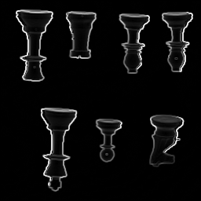
Gradient Magnitude Output
This image takes the original pixels from chess.pgm, and replaces the each pixel’s value using the magnitude formula discussed earlier.
This image does not use any threshold.

Slide 16
Consider this picture

Slide 17
Consider this picture

Slide 18
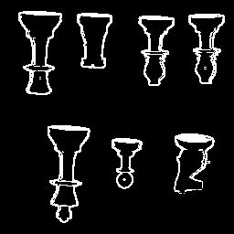
Magnitude Output with a low bar (threshold number)
This image takes the pixel values from the previous image and uses a threshold to decide whether it is an edge and then for edges it replaces the pixel’s value with a 255. If it is not an edge, it replaces the pixel’s value with a 0.

Slide 19
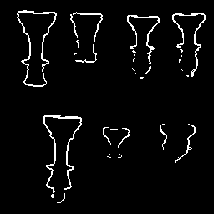
Magnitude Output with a high bar (threshold number)
The higher threshold means that greater changes in brightness must be present to be considered an edge.
Edges have thinned out, but horses head and other parts of the
pawn have disappeared. We can hardly see the edges on the
bottom two pieces.

Slide 20
Magnitude Formula in the c Code
/* Applying the Magnitude formula in the code*/
maxival = 0;
for (i=mr;i<256-mr;i++)
{ for (j=mr;j<256-mr;j++)
{
ival[i][j]=sqrt((double)((outpicx[i][j]*outpicx[i][j]) +
(outpicy[i][j]*outpicy[i][j]));
if (ival[i][j] > maxival)
maxival = ival[i][j];
}
}
Notes:
Make another slide that shows first half of Sobel.c code

Slide 21
Edge Detection
Graph shows one line of pixel values from an image.
Where did this graph come from?
Notes:
Add box with A and B moving from one pair of pixels to another. The data is processed in a sequential manner.
Box moves and it should record

Slide 22
Smoothening before Difference
Smoothening in this case was obtained by averaging two
neighboring pixels.
Notes:
Add box with A and B moving from one pair of pixels to another. The data is processed in a sequential manner.
Box moves and it should record

Slide 23
Edge Detection
Graph shows one line of pixel values from an image.
Where did this graph come from?
Notes:
Add box with A and B moving from one pair of pixels to another. The data is processed in a sequential manner.
Box moves and it should record

Slide 24
Smoothening rationale
Smoothening: We need to smoothen before we apply the derivative convolution.
We mean read an image, smoothen it, and then take it’s gradient.
Then apply the threshold.

Slide 25
The Four Ones
The way we will take an average of four neighboring pixels is to convolve the pixels with
[ ]
¼ ¼
¼ ¼
Convolving with this is equal to a + b + c + d divided by 4.
(Where a,b,c,d are the four neighboring pixels.)

Slide 26
Four Ones, cont.
[ ]
[ ]
¼ ¼
¼ ¼
1 1
1 1
Can also be written as:
1/4
Meaning now, to get the complete answer, we should
compute:
( )
[ ]
[ ]
[ ]
1 1
1 1
-1 +1
-1 +1
Image
*
*
1/4

Slide 27
Four Ones, cont.
( )
[ ]
[ ]
[ ]
1 1
1 1
-1 +1
-1 +1
1/4
Image
*
*
By the associative property of convolution we get this next step.
[ ]
[ ]
( )
[ ]
1 1
1 1
-1 +1
-1 +1
1/4
Image
*
*
We do this to call the convolution code only once, which precomputes
The quantities in the parentheses.

Slide 28
Four Ones, cont.
[ ]
( )
[ ]
[ ]
*
1 1
1 1
-1 +1
-1 +1
1/4
Image
*
We will be getting rid of the 1/4 factor, because it turns out that
when we forget about it, to fix our forgetfulness, we merely need to
raise our threshold by a factor of 4 (which is O.K. because we
were quite arbitrary about how to pick a threshold).

Slide 29
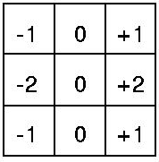
Four Ones, cont.
( )
[ ]
1 1
1 1
[ ]
-1 +1
-1 +1
*
As we did in the convolution slide:
We combine this to get:
This table is a result of doing
a scanning convolution.

Slide 30
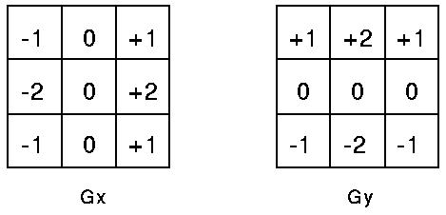

First these two masks are applied to the image.
The magnitude of the gradient is then calculated using the formula which we have seen before:
Then, the two output tables of the masks and image are combined using the magnitude formula. This gives us a smoothened gradient magnitude output.

Slide 31
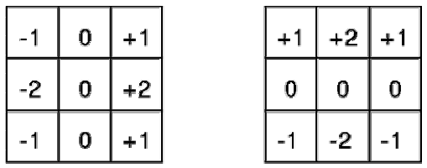
Sobel Algorithm…another way to look at it.
The Sobel algorithm uses a smoothener to lessen the effect of noise present in most images. This combined with the Roberts produces these two – 3X3 convolution masks.
G_{x} Gy

Slide 32

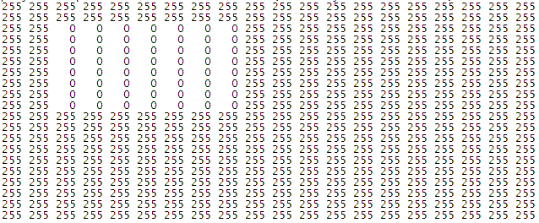
Step 1 – use small image with only black (pixel value = 0) and white (pixel value = 255)
20 X 20 pixel image of black box on square white background
Pixel values for above image
This is the original image. Nothing has been applied to it yet
Notes:
Put this at beginning

Slide 33
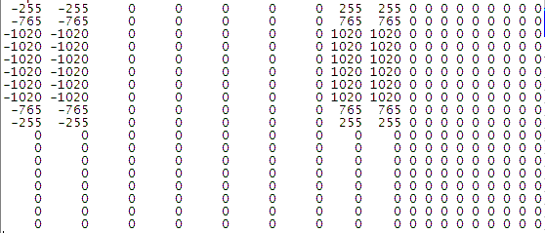
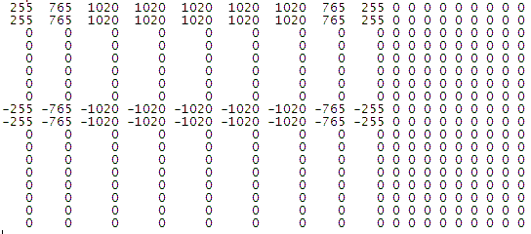
Step 2 – Apply Sobel masks to the image,
first the x and then the y.
X mask values
The masks are then convolved with the x and y masks. These are the results of the convolution
Y mask values

Slide 34
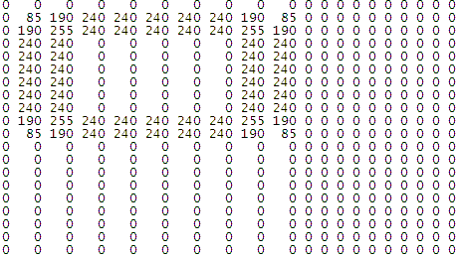
Step 3 – Find the Magnitudes using the formula c = sqrt(X² + Y²)
X mask
^ Using the formula above, the X mask and the Y mask of the image is combined to create the magnitude image below. This is applied to each individual pixel.
Magnitudes
Y mask

Slide 35


Step 4 – Apply threshold, say 150, to the combined image to produce final image.
Before threshold
The left image is the image combined with masks. The right image uses a threshold to separate the grey into either 0 or 255.
After threshold of 150
These are the edges it found

